Slide 1


CYBER SECURITY & APPLIED CRYPTOGRAPHY
Other Cyber Security Frameworks
Er. Prakash Chandra Adhikari

Slide 2
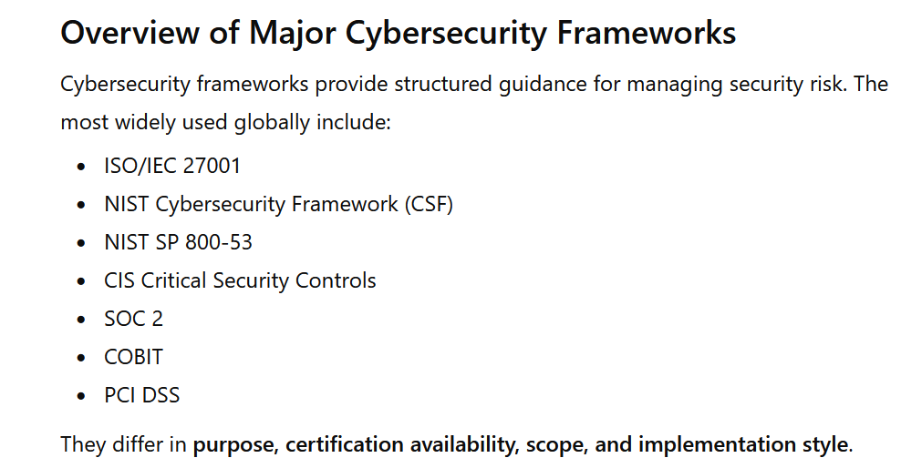
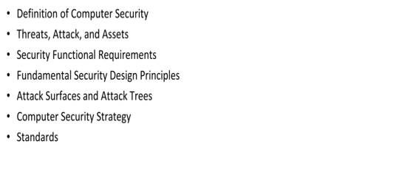
Overview

Slide 3
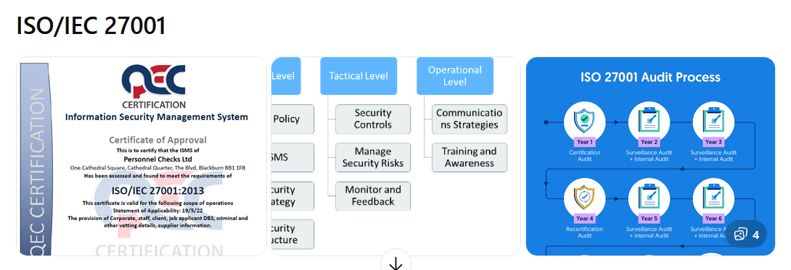
ISO/IEC 27001-

Slide 4
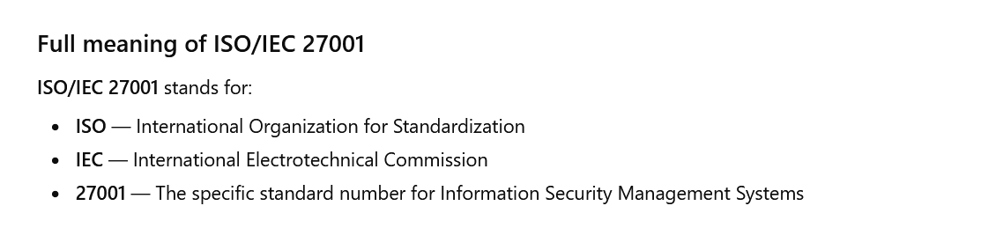
ISO/IEC 27001-

Slide 5
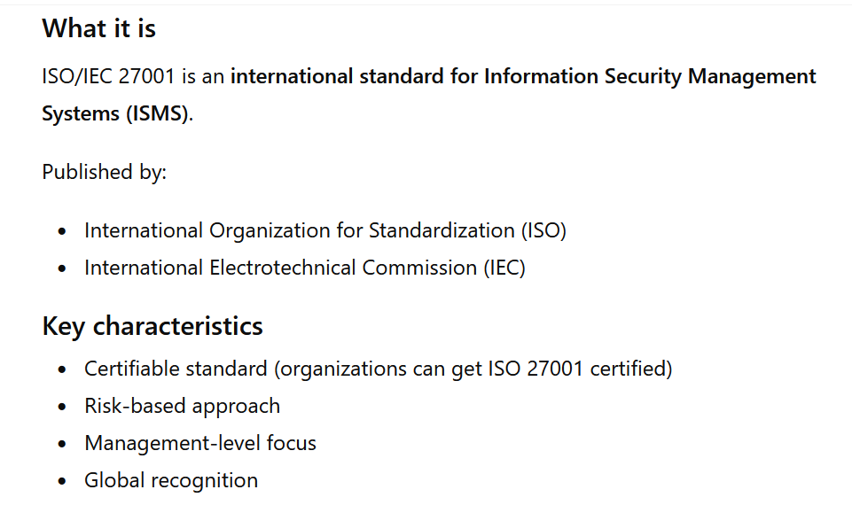
ISO/IEC 27001

Slide 6
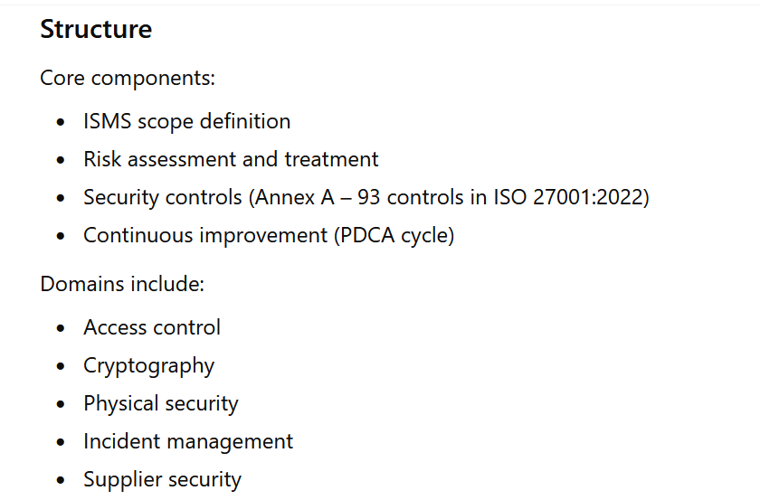
ISO/IEC 27001

Slide 7
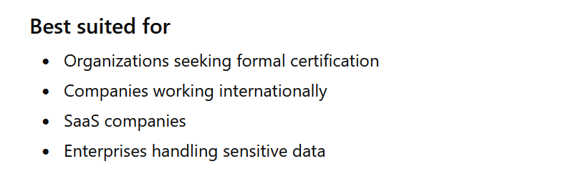
ISO/IEC 27001

Slide 8
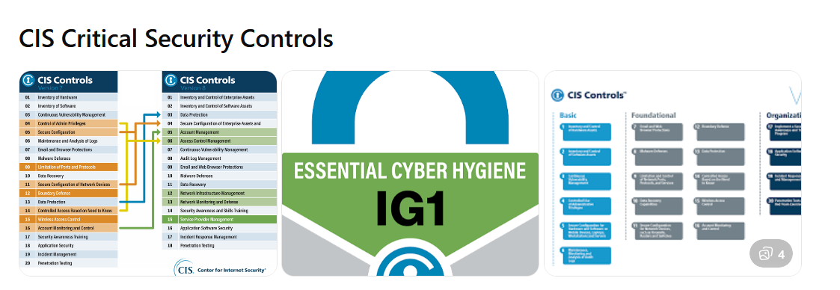
NIST SP 800-53

Slide 9
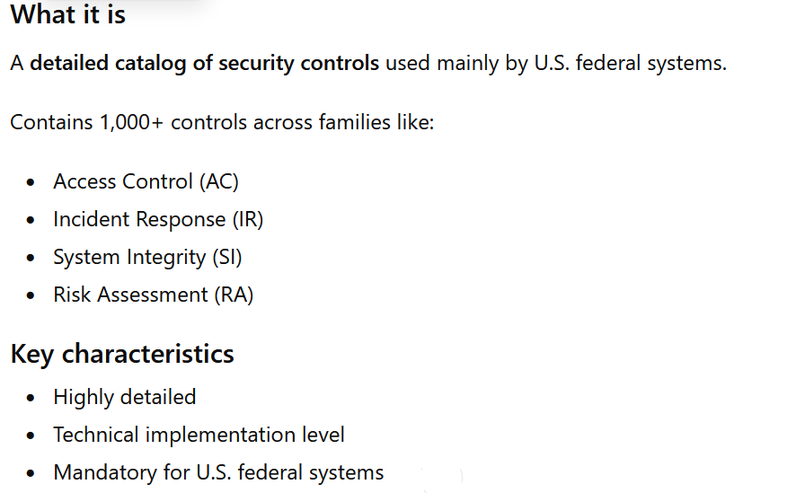
NIST SP 800-53

Slide 10
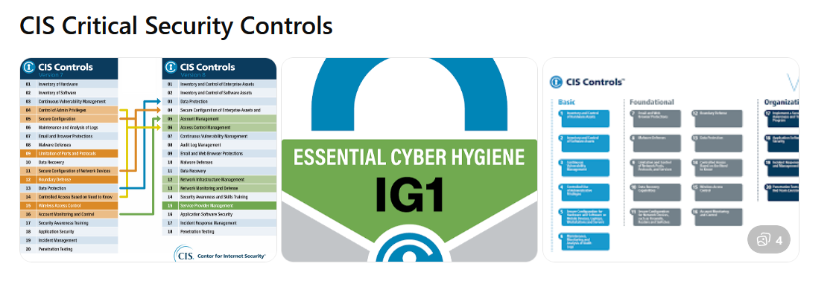
CIS Critical Security Controls

Slide 11
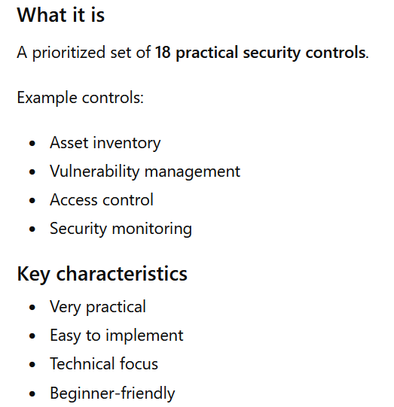
CIS Critical Security Controls

Slide 12
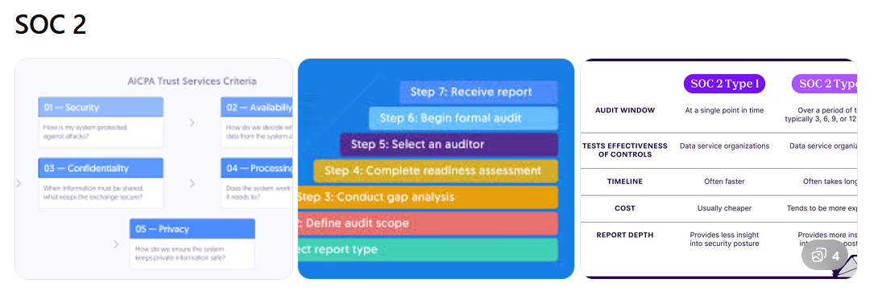
SOC 2

Slide 13
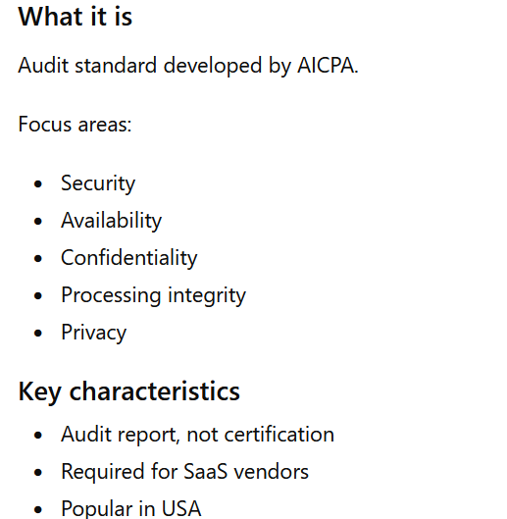
SOC 2-System and Organization Controls 2

Slide 14
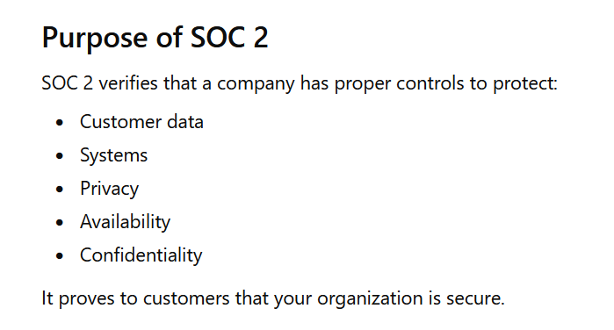
SOC 2-System and Organization Controls 2

Slide 15
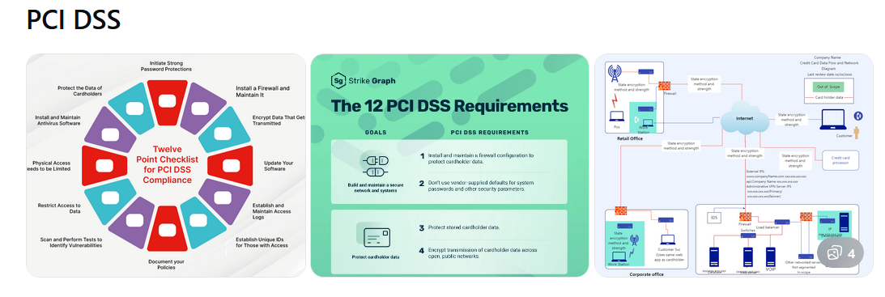
PCI DSS(Payment Card Industry Data Security Standard)

Slide 16
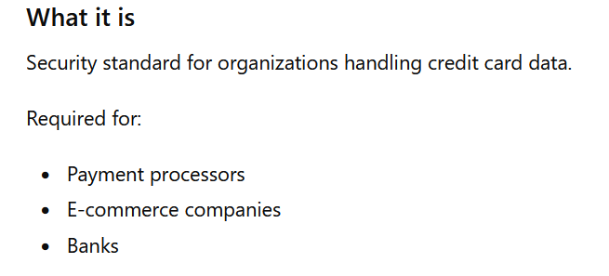
PCI DSS

Slide 17
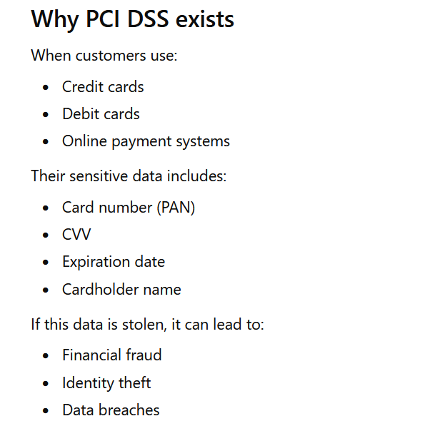
PCI DSS

Slide 18
Comparisons
Feature | ISO 27001 | NIST CSF | NIST 800-53 | CIS Controls | SOC 2 | PCI DSS
Type | Standard | Framework | Control catalog | Control set | Audit standard | Compliance standard
Certification | Yes | No | No | No | Audit report | Yes
Origin | International | USA | USA | USA | USA | Global payments
Focus | Management system | Risk management | Technical controls | Practical security | Service providers | Payment security
Flexibility | Medium | Very high | Low | High | Medium | Low
Technical depth | Medium | Medium | Very high | High | Medium | High
Best for | Enterprises, global | All organizations | Government | Beginners, SMB | SaaS | Payment systems

